Slide 1
TASK-3

Slide 2
INFRASTRUCTURE AS CODE (IAC) DESIGN WITH TERRAFORM
DONE BY SAI SARAN

Slide 3
Introduction to Terraform and IAC
Terraform:
Terraform is an open-source tool developed by HashiCorp that enables Infrastructure as Code (IaC).
It allows you to define, provision, and manage infrastructure across a wide range of service providers, such as AWS, Azure, Google Cloud, and more, through simple configuration files.
Infrastructure as Code (IaC):
Infrastructure as Code (IaC) is the practice of managing and provisioning computing infrastructure through machine-readable configuration files rather than physical hardware or interactive configuration tools.
IaC allows developers and system administrators to define and manage infrastructure in a consistent, repeatable, and automated way.

Slide 4
Why Terraform
There are multiple reasons why Terraform is used over the other IaC tools but below are the main reasons.
Multi-Cloud Support
Large Ecosystem
Declarative Syntax
State Management
Plan and Apply
Integration with Other Tools
HCL Language

Slide 5
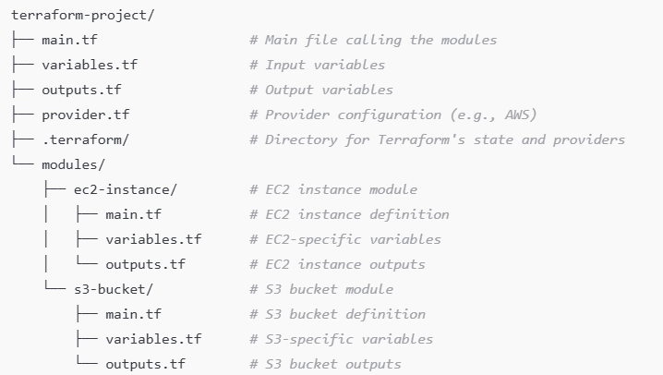
Terraform Tree
Terraform tree refers to the visualization or structure of the resources, modules, and dependencies within a Terraform configuration.
How Terraform Tree Looks (Conceptually):
Imagine you are building a project where you define multiple resources (e.g., EC2 instances, S3 buckets) and organize them into modules. Here's an example of how this structure could look as a "tree“

Slide 6
Use Cases of Terraform Tree:
Organizing Infrastructure
Reusability
Managing Large Projects
Documentation
Terraform Tree refers to how Terraform resources and modules are structured in your project.
It is useful for organizing, managing, and reusing infrastructure configurations in a modular way.

Slide 7
Terraform commands
terraform init:
To Initializes a Terraform configuration directory, downloading necessary provider plugins and setting up the working environment.
terraform plan:
Generates an execution plan. It shows what changes Terraform will make to your infrastructure, based on your current configuration files and state.
terraform apply:
Applies the changes to your infrastructure as defined in your configuration files. After you review the plan, this command will make the actual changes (create, update, or delete resources).
terraform destroy:
Destroys the infrastructure managed by Terraform.
terraform show:
Displays the current state or the plan that was created with terraform plan.

Slide 8
Creating Terraform Tree
STEP 1: Open Visual studio code and create new folder or select an existing folder.
STEP 2: In that folder again create a new folder and provide one name for the folder.
STEP 3: After creating a new folder again create a new folder in that folder create a new file for VPC, Subnets, Security groups, Internet gateway and NAT gateway.

Slide 9
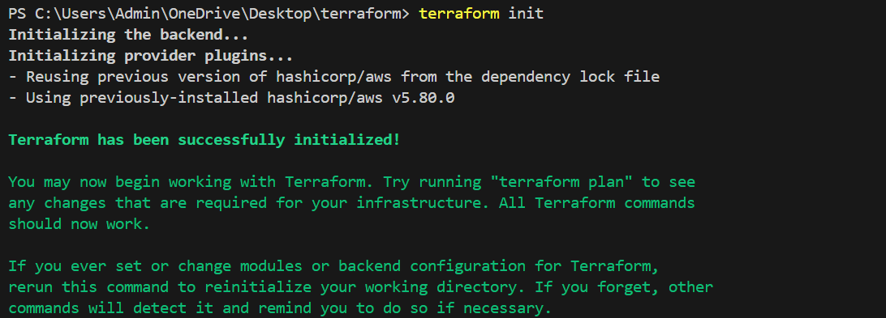
Creating VPC Using Terraform
STEP4: Create a new file in VPC_Creation folder.
Here I have created a new file and named it as vpc.tf
STEP5: Paste the following code in the file and open
The New Terminal
STEP6: Then do the aws Configure and do the
terraform init
provider "aws" {
region = "ap-northeast-1"
}
resource "aws_vpc" "demo-vpc" {
cidr_block = "10.0.0.0/16"
tags = {
Name = "My-vpc"
}
}

Slide 10
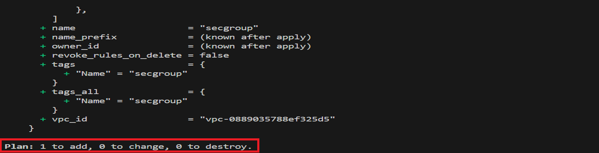
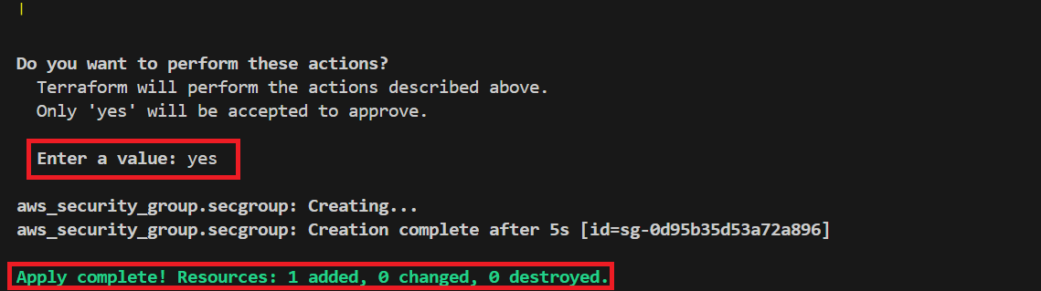
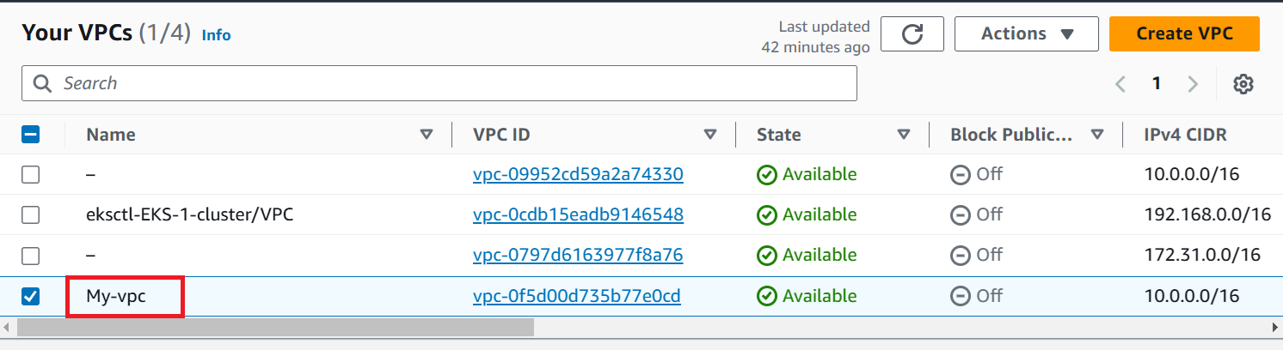
terraform plan
terraform apply
VPC Console Output

Slide 11
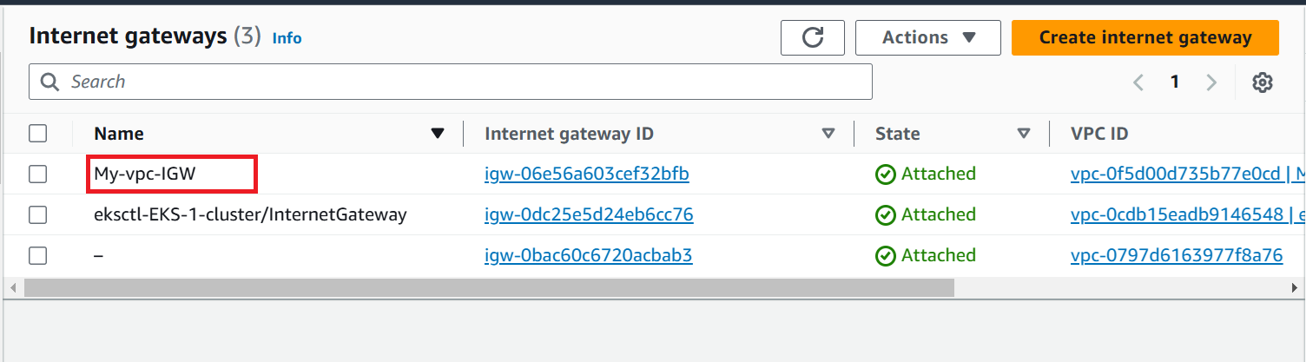
Creating INTERNET GATEWAY Using Terraform
STEP7: Again Create a new file in VPC_Creation .
Here I have created a new file and named it as igw.tf
STEP8: Paste the following code in the file and open
The New Terminal
STEP9: Then do the terraform init, terraform plan and
terraform apply
resource "aws_internet_gateway" "demo-igw" {
vpc_id = aws_vpc.demo-vpc.id
tags = {
Name = "My-vpc-IGW"
}
}

Slide 12
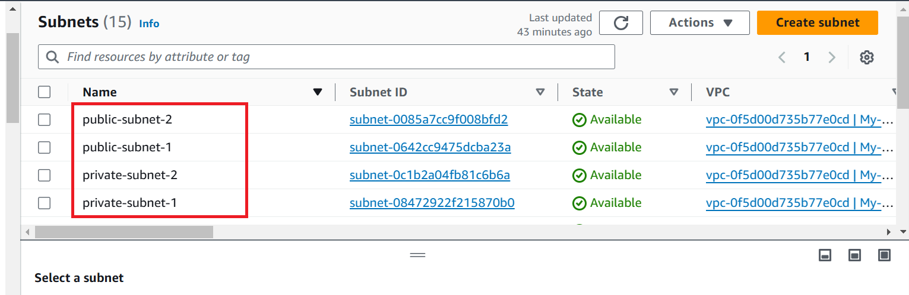
Creating Subnets Using Terraform
resource "aws_subnet" "private-subnet-1" {
vpc_id = aws_vpc.demo-vpc.id
cidr_block = "10.0.1.0/24"
availability_zone = "ap-northeast-1a"
tags = {
Name = "private-subnet-1"
}
} resource "aws_subnet" "private-subnet-2" {
vpc_id = aws_vpc.demo-vpc.id
cidr_block = "10.0.2.0/24"
availability_zone = "ap-northeast-1c"
tags = {
Name = "private-subnet-2"
}
} resource "aws_subnet" "public-subnet-1" {
vpc_id = aws_vpc.demo-vpc.id
cidr_block = "10.0.3.0/24"
availability_zone = "ap-northeast-1a"
tags = {
Name = "public-subnet-1"
}
}
resource "aws_subnet" "public-subnet-2" {
vpc_id = aws_vpc.demo-vpc.id
cidr_block = "10.0.4.0/24"
availability_zone = "ap-northeast-1c"
tags = {
Name = "public-subnet-2"
}
}
STEP10: Again Create a new file in VPC_Creation .
Here I have created a new file and named it as subnets.tf
STEP11: Paste the following code in the file and open
The New Terminal
STEP12: Then do the terraform init, terraform plan and
terraform apply

Slide 13
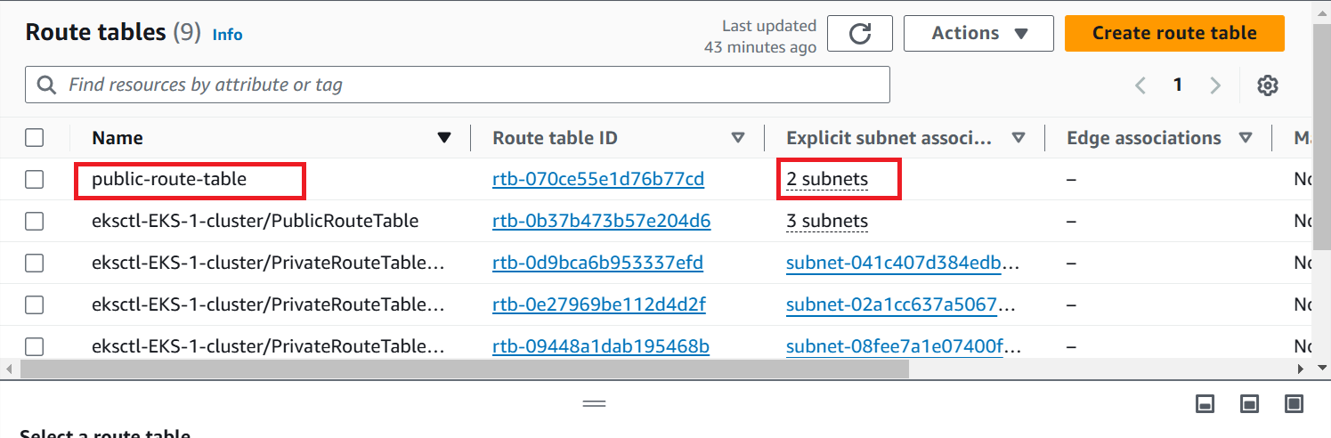
Creating Route Tables Using Terraform
STEP13: Again Create a new file in VPC_Creation .
Here I have created a new file and named it as
Routetable.tf
STEP14: Paste the following code in the file and open
The New Terminal
STEP15: Then do the terraform init, terraform plan and
terraform apply
resource "aws_route_table" "public-route-table" {
vpc_id = aws_vpc.demo-vpc.id
tags = {
Name = "public-route-table"
}
}
resource "aws_route" "public-route" {
route_table_id = aws_route_table.public-route-table.id
destination_cidr_block = "0.0.0.0/0"
gateway_id = aws_internet_gateway.demo-igw.id
}
resource "aws_route_table_association" "public-subnet-1-association" {
subnet_id = aws_subnet.public-subnet-1.id
route_table_id = aws_route_table.public-route-table.id
}
resource "aws_route_table_association" "public-subnet-2-association" {
subnet_id = aws_subnet.public-subnet-2.id
route_table_id = aws_route_table.public-route-table.id
}

Slide 14
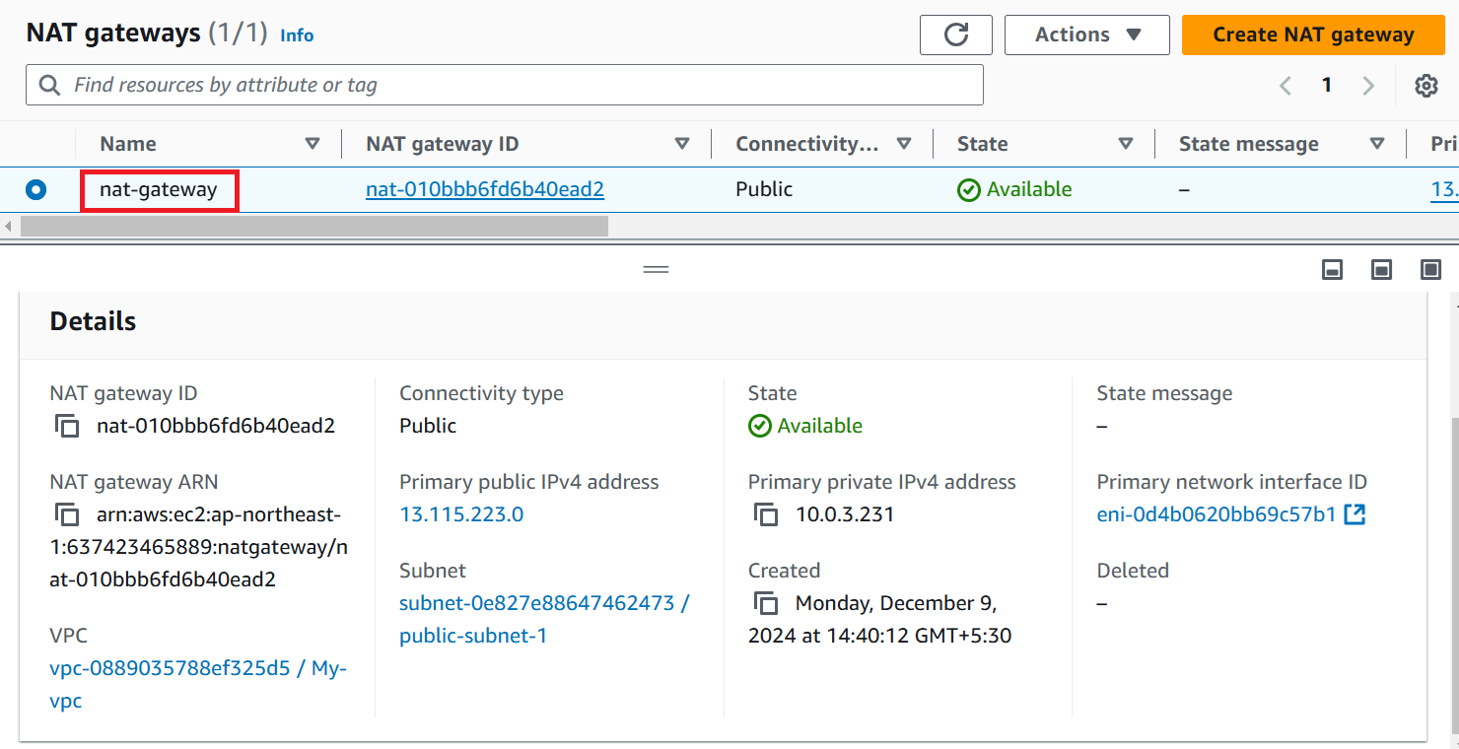
Creating NAT Gateway Using Terraform
STEP16: Again Create a new file in VPC_Creation .
Here I have created a new file and named it as nat.tf
STEP17: Paste the following code in the file and open
The New Terminal
STEP18: Then do the terraform init, terraform plan and
terraform apply
resource "aws_eip" "nat-eip" {
vpc = true
}
resource "aws_nat_gateway" "nat-gateway" {
allocation_id = aws_eip.nat-eip.id
subnet_id = aws_subnet.public-subnet-1.id
tags = {
Name = "nat-gateway"
}
}

Slide 15
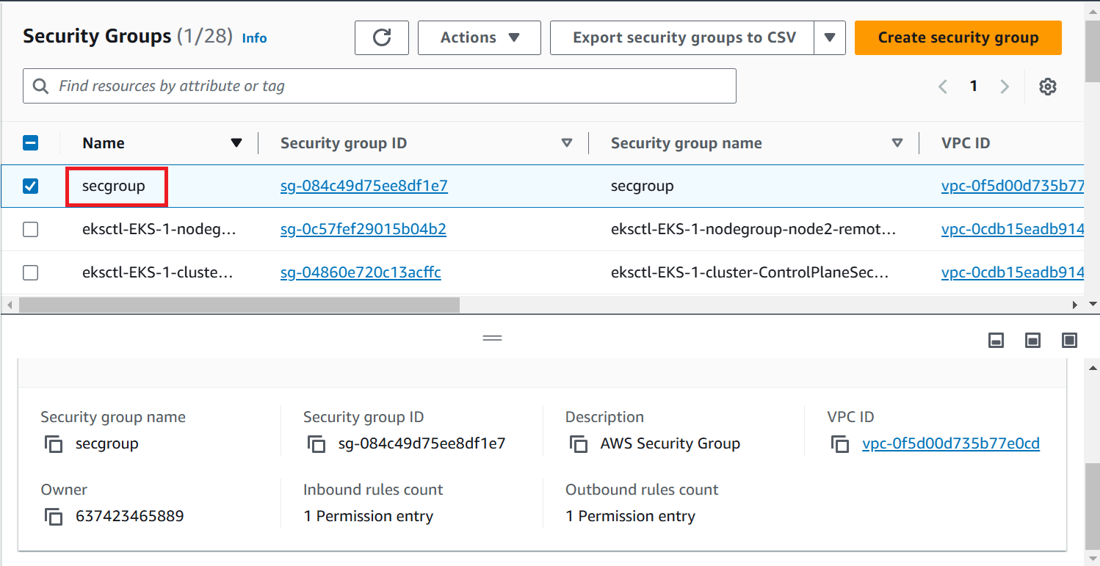
Creating Security group Using Terraform
STEP19: Again Create a new file in VPC_Creation .
Here I have created a new file and named it as security.tf
STEP20: Paste the following code in the file and open
The New Terminal
STEP21: Then do the terraform init, terraform plan and
terraform apply
resource "aws_security_group" "secgroup" {
name = "secgroup"
description = "AWS Security Group"
vpc_id = aws_vpc.demo-vpc.id
ingress {
from_port = 0
to_port = 65535
protocol = "tcp"
cidr_blocks = ["0.0.0.0/0"]
}
egress {
from_port = 0
to_port = 65535
protocol = "tcp"
cidr_blocks = ["0.0.0.0/0"]
}
tags = {
Name = "secgroup"
}
}

Slide 16
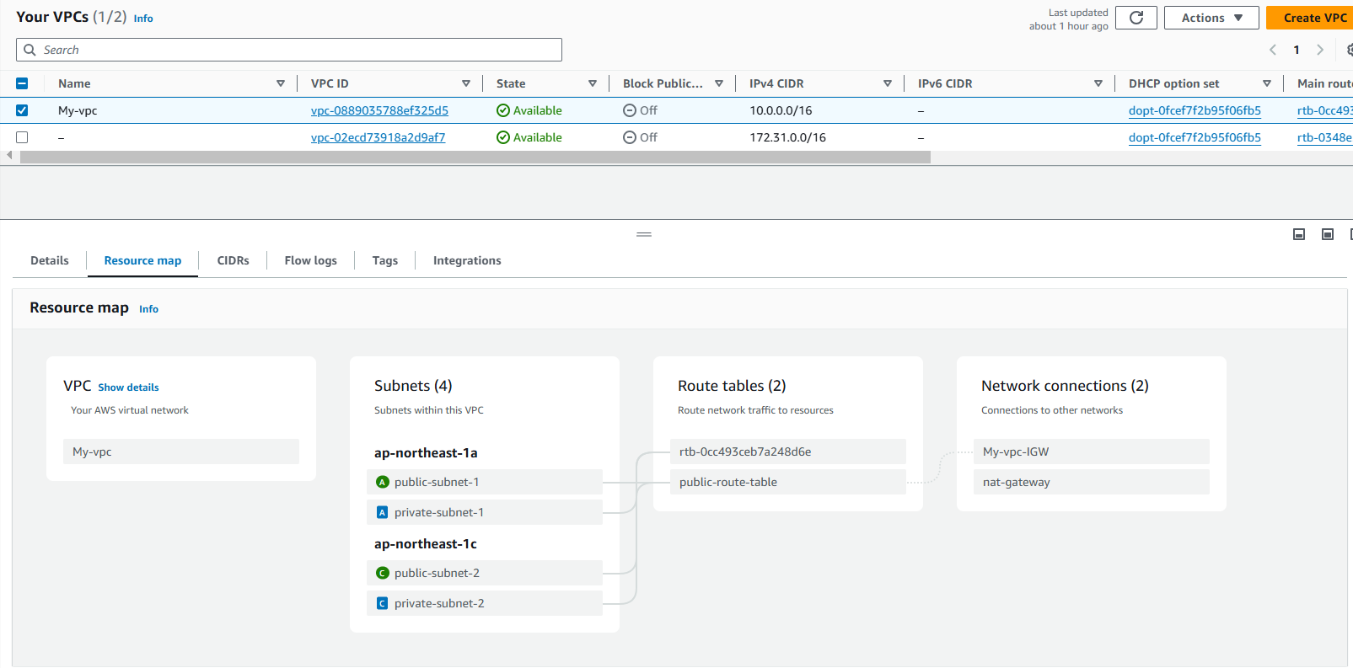
VPC Resource Map

Slide 17
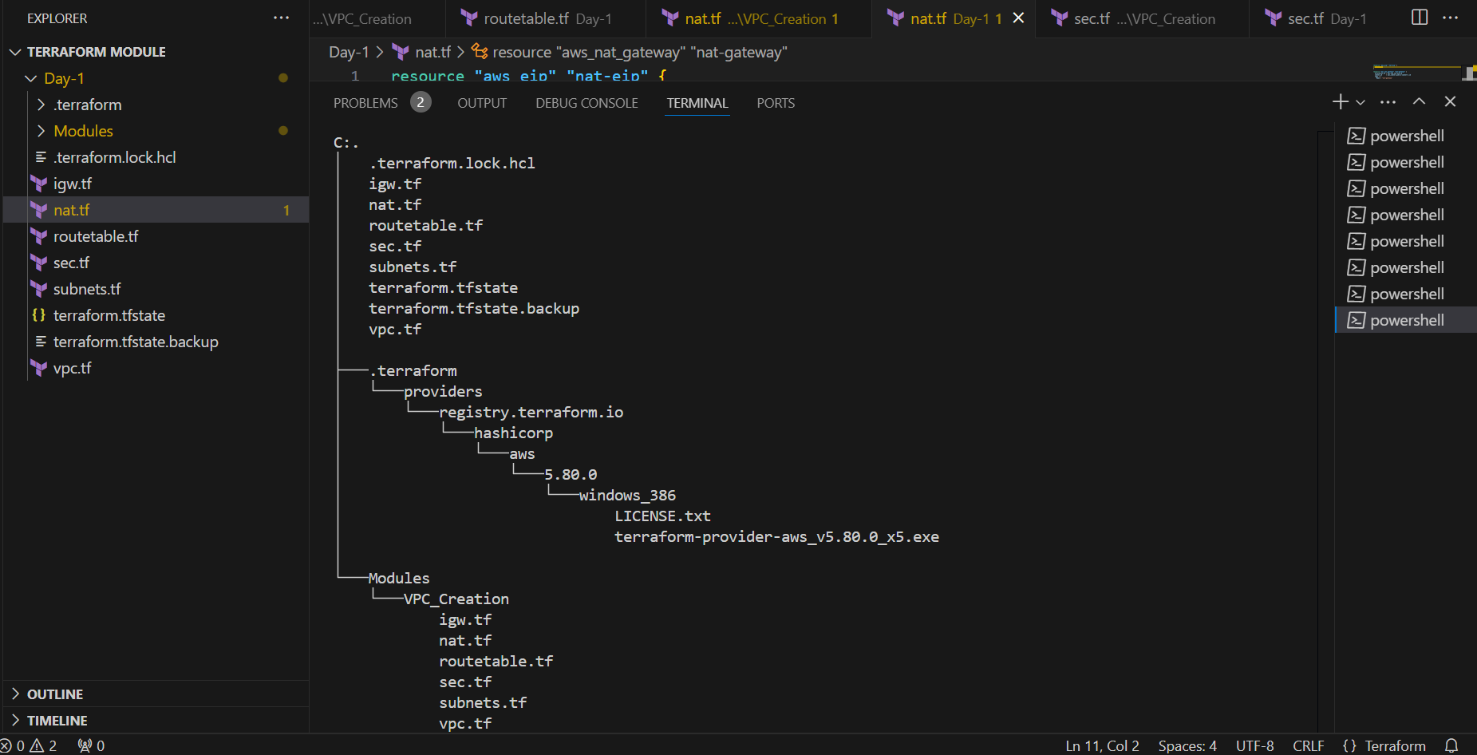
Terraform Tree Structure

Slide 18


